Slide 1
COUPON PREDICTION
ARTIFICIAL INTELLIGENCE AND MACHINE LEARNING (COURSE PROJECT)
by
Under the guidance of: 2103a51495(vishal mary)
Mr.s.naresh kumar 2103a51512(ashmitha)

Slide 2
ABSTRACT
Our project is based on user data analysis which is used to predict what coupon a user will get based on his previous purchases and transactions from the site. Issuing discount shopping coupons and barter purchase is a popular way to promote sales in E-commerce environments. In order to improve the coupon usage ratio, it is important to predict the probability in which a user will get a coupon. To treat the coupon redemption probability prediction problem as a binary classification problem, we use machine learning methods to analyze users' coupon usage behavior and coupon purchase prediction. Coupon prediction refers to the process of using data analytics and machine learning techniques to forecast the likelihood of a customer getting a particular coupon or offer. This practice is essential for businesses in the retail and e-commerce industries, as it allows them to optimize their marketing strategies by targeting customers who are most likely to use coupons and offers. By analyzing customer data such as past purchase and transactions, and other relevant factors, businesses can predict which customers are more likely to get coupon promotions and tailor their marketing efforts accordingly. Predictive models can also help businesses optimize the timing and distribution of coupons and offers to maximize their effectiveness. The benefits of coupon prediction include improved targeting, increased redemption rates, and a better return on investment for marketing efforts. Overall, coupon prediction is a valuable tool for businesses looking to optimize their marketing strategies and improve customer engagement.

Slide 3
CONTENTS
INTRODUCTION
OVERVIEW
PROBLEM STATEMENT
EXISTING SOLUTION
PROPOSED SOLUTION
OBJECTIVES
OVERALL ARCHITECTURE
DATA PRE-PROCESSING
DESCRIBE DATASET
DATA CLEANING
DATA AUGMENTATION
DATA VISUALIZATION

Slide 4
CONT.CONTENTS
METHODOLOGY
PROCEDURE TO SOLVE THE GIVEN PROBLEM
MODEL ARCHITECTURE
SOFTWARE DESCRIPTION
RESULTS AND DISCUSSION
CONCLUSION AND FUTURE SCOPE
REFERENCES

Slide 5
INTRODUCTION
OVERVIEW:
A coupon prediction project involves applying data analytics and machine learning techniques to develop a predictive model for coupon prediction to the customers. The project typically involves collecting and analyzing customer data, such as past purchase, previous transcations and other relevant factors that may influence coupon usage. The data is then used to train a machine learning model that can predict which customers are most likely given a coupon and which coupons are likely to be redeemed. The benefits of a coupon prediction project include increased targeting, higher redemption rates, and improved return on investment for marketing efforts. A successful coupon prediction project can help businesses to optimize their marketing strategies and improve customer engagement, leading to increased sales and customer loyalty.
PROBLEM STATEMENT:
Many businesses in the retail and e-commerce industries struggle to optimize their coupon and offer distribution strategies due to a lack of data-driven insights. They often rely on a trial-and-error approach to distribute coupons and offers, which can result in low redemption rates and wasted marketing resources. To address this challenge, we aim to develop a predictive model that can identify which customers are most likely to respond to coupon promotions and which coupons are likely to be redeemed. By using customer data and machine learning algorithms to predict coupon usage, we aim to improve the targeting and effectiveness of our coupon distribution strategy and increase customer engagement and sales.

Slide 6
CONTD.INTRODUCTION
EXISTING SYSTEM:
Customer segmentation is one of the existing model it is the process of dividing customers into groups based on common characteristics such as demographics, behaviour, preferences, and needs. A customer segmentation model is a statistical tool used to identify meaningful segments of customers that have similar characteristics, behaviours, or needs. It uses statistical methods to cluster customers into distinct groups based on the segmentation criteria. Each group should be as homogenous as possible with respect to the criteria being used to segment them and as different as possible from other groups.
PROPOSED SOLUTION:
Here we want to predict the coupon to the customer based his/her transaction history and depending upon their item purchases the customer gets the coupon discount . This is a machine learning algorithm to predict which coupons will be most effective for different types of customers based on their purchase history and other factors. This involves looking at past coupon usage data to identify patterns and trends that can be used to make predictions about future purchases.
OBJECTIVES:
The main objectives of coupon prediction are to:
Increase coupon redemption rates, Improve customer satisfaction, Increase sales,Reduce marketing costs,Optimize inventory management

Slide 7
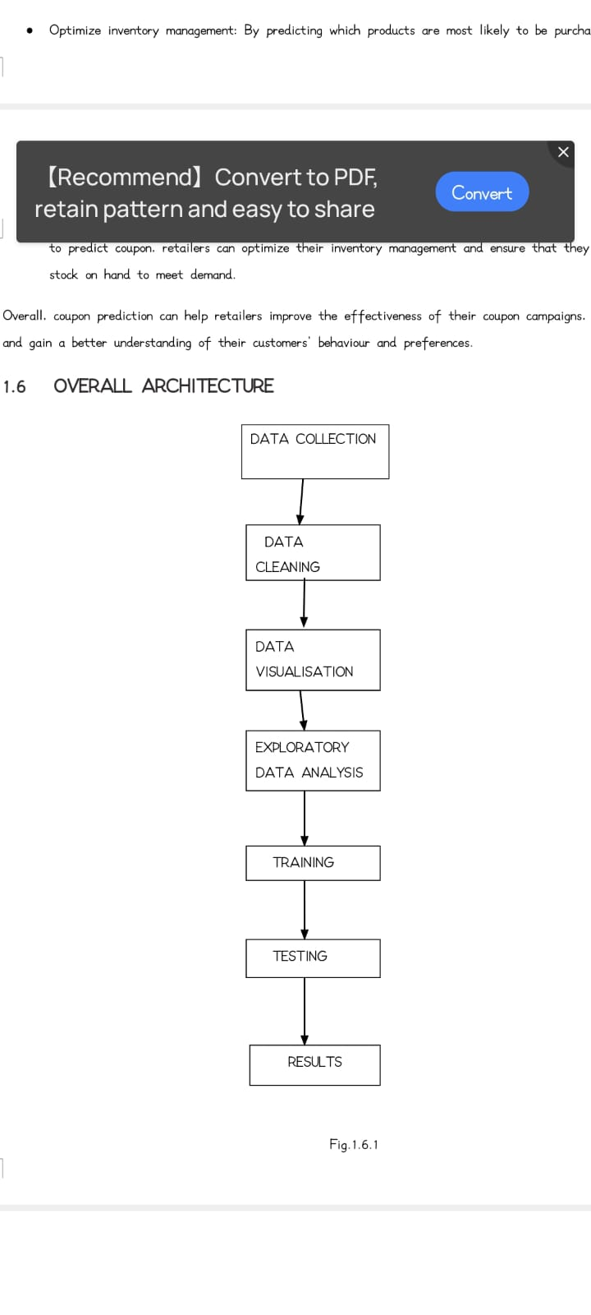
CONTD.INTRODUCTION
OVERALL ARCHITECTURE:

Slide 8
DATA PRE-PROCESSING
DESCRIBE DATASET:
Our dataset is a collection of data from different resources and our dataset contains 151 rows and 7 Columns.The 7 main attributes of our dataset are GENDER , ITEM1, ITEM2, ITEM3, TRANSACTIONS, COUPON, COUPON DISCOUNT.
1 .GENDER: The Gender of the customer to predict the coupon regarding their uses with help of Gender.
Our dataset consists of Gender Female and Male,
2.ITEMS: It is the group of the items.
Computer Games, Toys,Educational Products,Cosmetics,Womens Wear,Kids Wear,Handbag,Movies,Board Games,Mens Wear,Candy,Gym Shoes,Tie,Heels.
3.COUPONS:These are the coupons assigned or predicted to thecustomers and the following are they
Kids Apparel,Mens Apparel, Women Apparel.
4. PREVIOUS TRANSACTIONS:
5.COUPON DISCOUNT

Slide 9
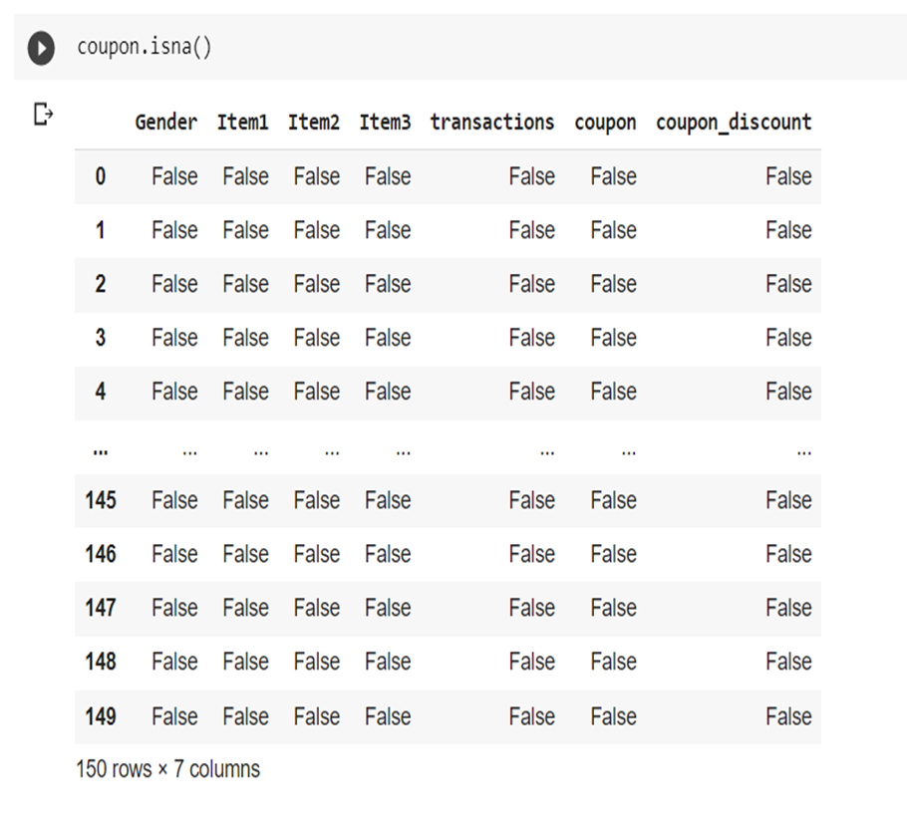
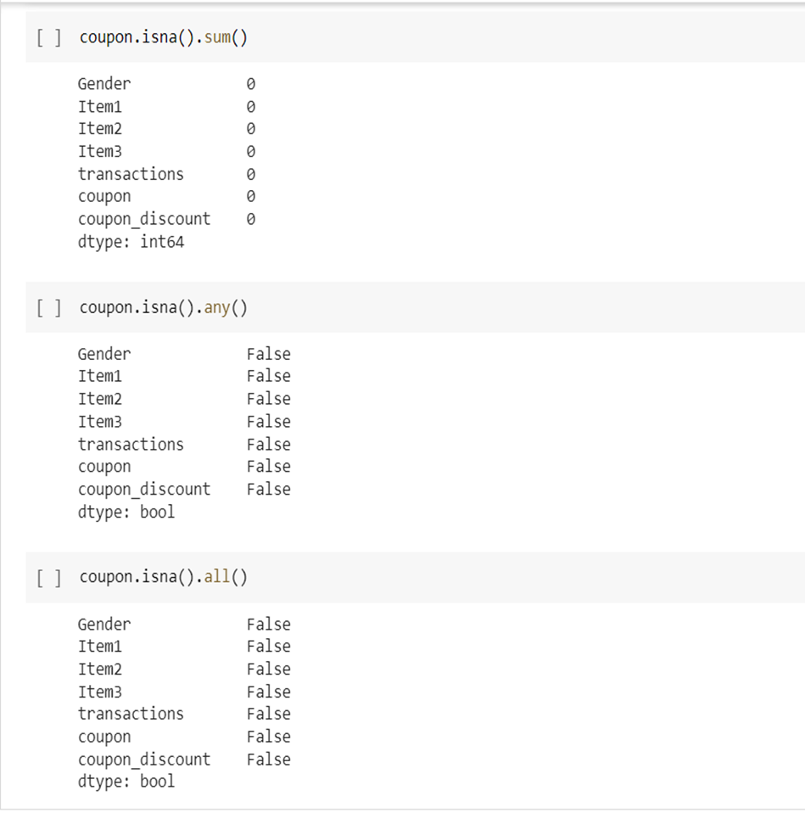
CONT’D DATA PRE-PROCESSING
DATA CLEANING:

Slide 10
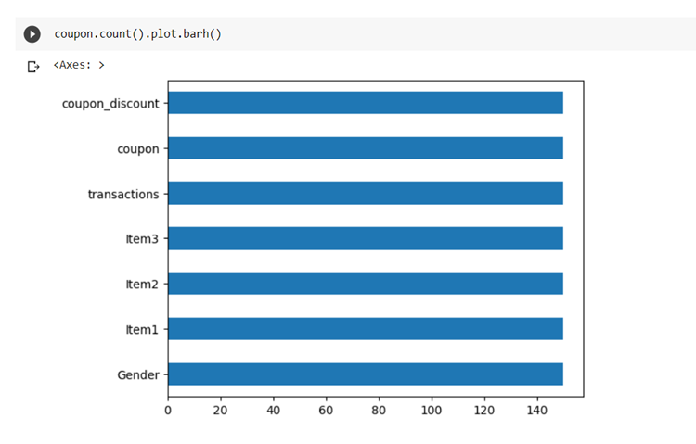
CONT’D DATA PRE-PROCESSING
DATA AUGMENTATION:
Data augmentation is a technique used in machine learning to increase the size and diversity of a training dataset by creating new training examples from existing ones. This can be particularly useful in coupon prediction tasks, where having a larger and more diverse training set can lead to better performance of the predictive model. Overall, data augmentation can be a powerful tool in coupon prediction tasks, allowing the model to learn from a larger and more diverse set of training examples and improving its ability to generalize to new and unseen data.
DATA VISUALIZATION:

Slide 11
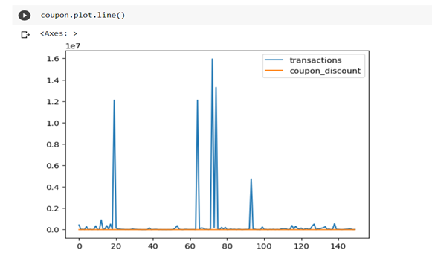
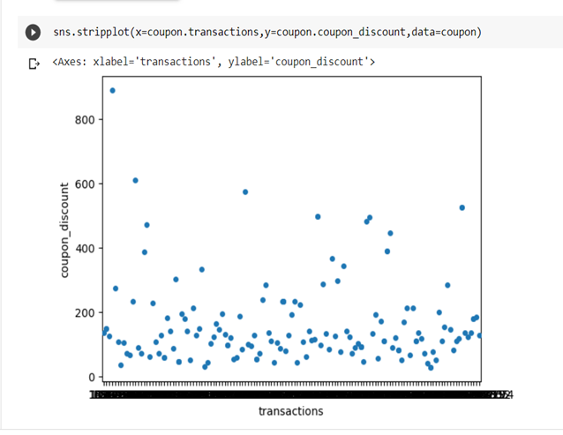
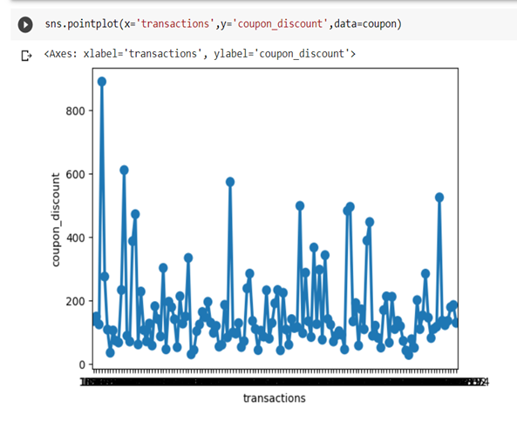
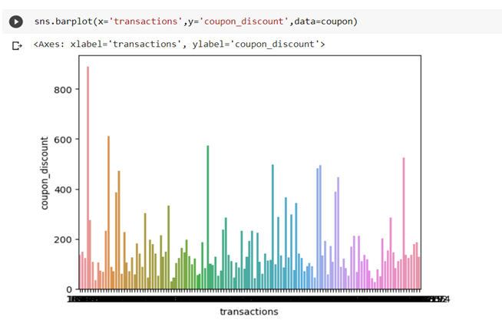

Slide 12
METHODOLOGY

Slide 13
RESULT AND DISCUSSION

Slide 14
CONCLUSION AND FUTURE SCOPE

Slide 15
RESULTS

